Slide 1
CSS
positioning of boxes

Slide 2
positioning HTML elements
Order in code determines order on screen
Two text columns next to each other?
Display menu on the right side of the screen ?
-> not possible without complicated tables

Slide 3
Document flow
standard document flow
top to bottom
left to right

Slide 4
Layout with CSS instead of tables
= “table-less” layout
box model:
dimensions of each box
Visual formatting model:
2 types boxes: determine display
block-box (e.g.: <h1>, <p>, …)
inline-box (e.g.: <img>, <span>, …)
positioning of each box

Slide 5
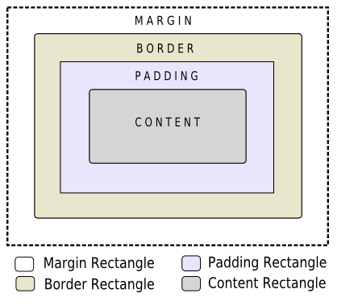
the box model
Width of parent element
Margin of
element
Border
Padding of
element
Height
of
parent
element
Height
of element
text and/or images
Width of element

Slide 6
Visual formatting model
block-box:
starts on a new line, starting from the left side of the page
takes up full width of page
inline-box:
shown ‘on the line’
multiple adjacent boxes are possible as long as there is space left on the line

Slide 7
positioningsschema’s
1. box model: dimensions van box bepalen
2. visual formatting model: weergave bepalen
3. positioning schemes:
determine how the content is shown
1. normal view
2. floating blocks
3. positioning

Slide 8
example: HTML
What is shown in browser?
<body>
<h2>Belgium</h2>
<p>
<img src="mapOfBelgium.gif" alt="Map of Belgium" title="Map of Belgium" />
Belgium (French: Belgique, German: Belgien), … the southeast and France in the south.
</p>
<p>
Belgium is made up of three communities: the Dutch-speaking, the
… and the Brussels-Capital Region.
</p>
<p>
The capital is Brussels, … European Union.
</p>
<p>
The name "Belgae" … until 1830.
</p>
</body>

Slide 9
Position
Normal view
Floats
float:left
float:right
Possible with all boxes!
e.g.: list

Slide 10
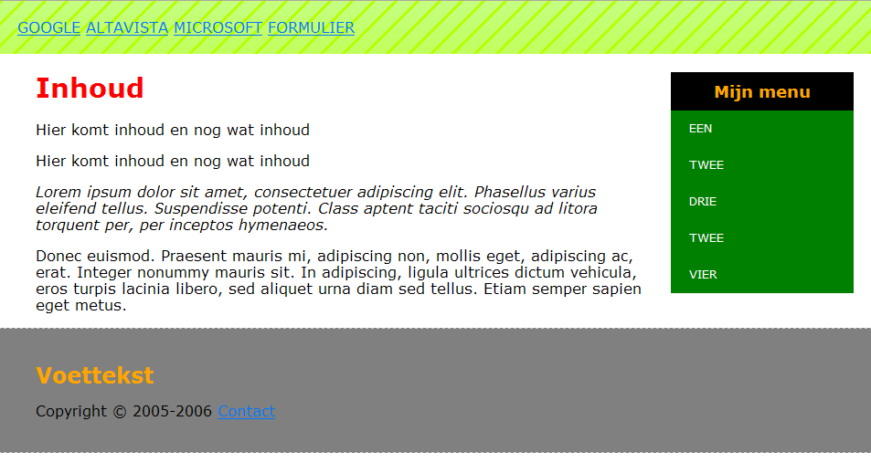
float
.menu{float:right;}

Slide 11
float
float: right;
shifts the element to the right side of the box (no vertical shift)
note: the floating element must have a defined width.
e.g.: .menu{width: 300px;}
What if the line contains multiple boxes with float:left?
volgorde??

Slide 12
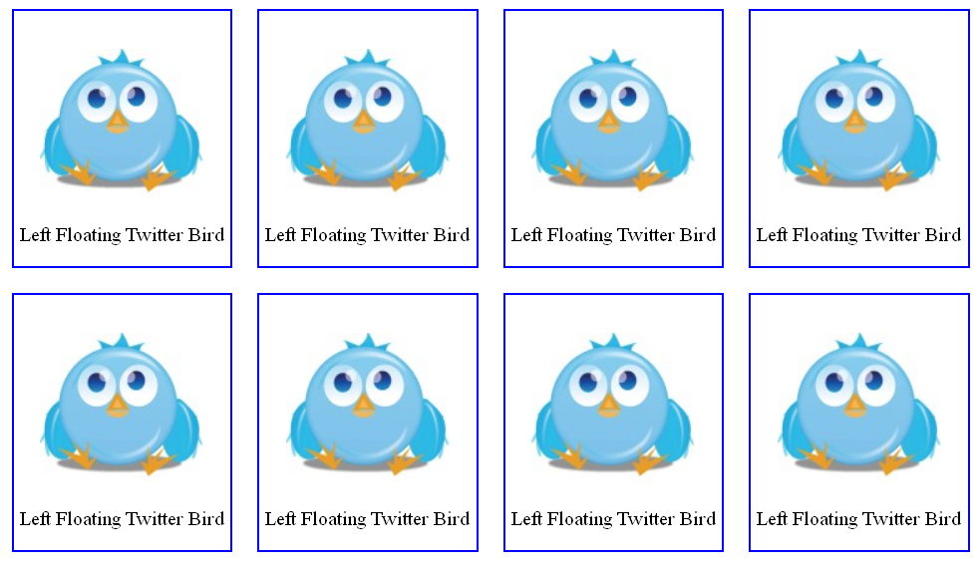
exercise floatingtwitter.html
div: width, border text-align: center, margin, float
img
text in p

Slide 13
clear
Elements behind floating element are placed besides that element => to avoid, use clear
clear:left/right => no floating elements allowed on the left / right side
clear:both => no floating elements allowed on either side
e.g. footer needs to be placed below all other elements
div.footer{clear: both;} -> makes sure footer positioned below all floating elements.

Slide 14
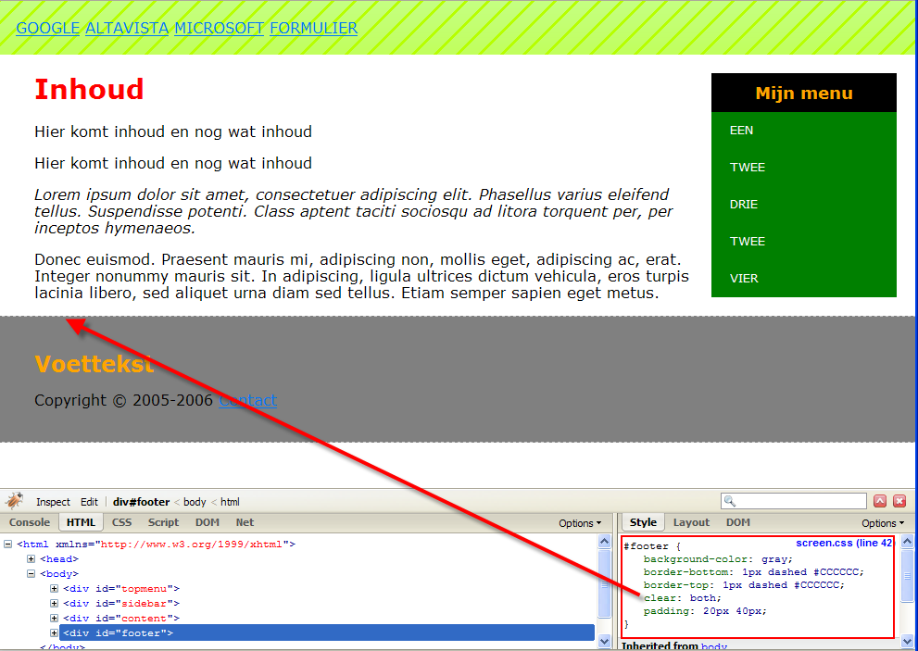

Slide 15
position
position: static;
standard, depending on order source code
position: relative; -> relative shift from normal position
position: absolute; -> defined spot
position: fixed; -> fixed also when you scroll

Slide 16
Position: relative
top, right, bottom, left
relative shift from normal position (static)
e.g.:
left: 50px; -> shifts element 50px to the right
right: -50px; -> exactly the same
do not define left and right, choose

Slide 17
position: absolute
there is no “normal” position
element is placed on the spot defined in CSS, regardless of any other content
overlap is possible:
elements defined later in source code overlap previous elements
change “stacking order” with z-index

Slide 18
position: fixed;
same position as absolute
position is fixed at all times, even if you scroll

Slide 19
“depth” in a page: z-index
Elements that are positioned with position (relative, absolute or fixed) can be “stacked” using z-index
z-index: auto; -> standard, the further the element appears in the HTML, the higher its level in the stack
z-index: integer; -> number, the higher the number, the higher the element level in the stack

Slide 20



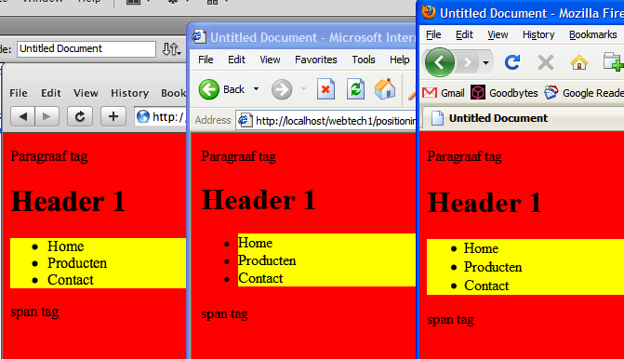
CSS Reset
Professional web design = looks the same on every browser
problem: default settings browsers

Slide 21
CSS Reset
Old solution:
*{margin:0; padding: 0;}
what does this do exaclty?
what could be the problem?
browser rendering agent
http://css-tricks.com/margin-0-padding-0-no-longer-cool/
No Longer Cool!

Slide 22
CSS Reset
Good solution:
CSS RESET
example of good CSS reset:
http://meyerweb.com/eric/tools/css/reset/

Slide 23
Implement CSS reset
good practice to use CSS RESET from the start of the project
implementation:
First link RESET CSS file (make all browsers behave equally)
then link own CSS file – Why!?

Slide 24
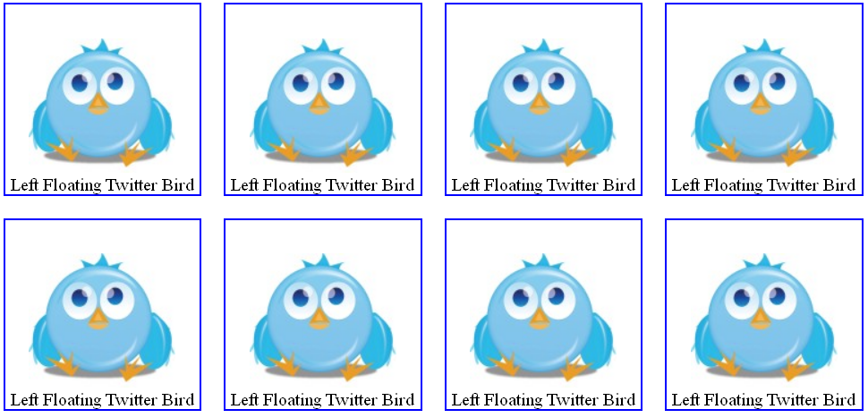
exercise floatingtwitter + reset

